Slide 1

Elders’ Retreat
New Jersey Conference

Slide 2

Returning Tithe and Offerings to the New Jersey Conference

Slide 3




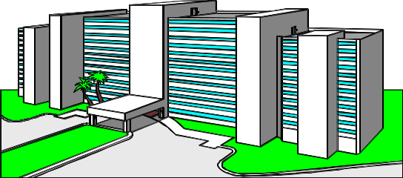

We all have deadlines
Church (10th)
Conference (15th)
Union (20th)
It is necessary for the world church to operate and plan effectively.
General Conference
Division (25th)
Notes:
1. The conference should receive reports and tithes on the 10th of each month. There is a large number of churches that are not delivering tithes and offerings on time. Elders should ensure that treasurers send remittances on time.

Slide 4

New Jersey Conference of SDA
Analysis of Remittances to September
Number off Churches | 106
Remittances out of time (No checks and no reports) | 37
Remittances not complete (Only checks without reports) | 4
Remittances out of time in% | 39%

Slide 5
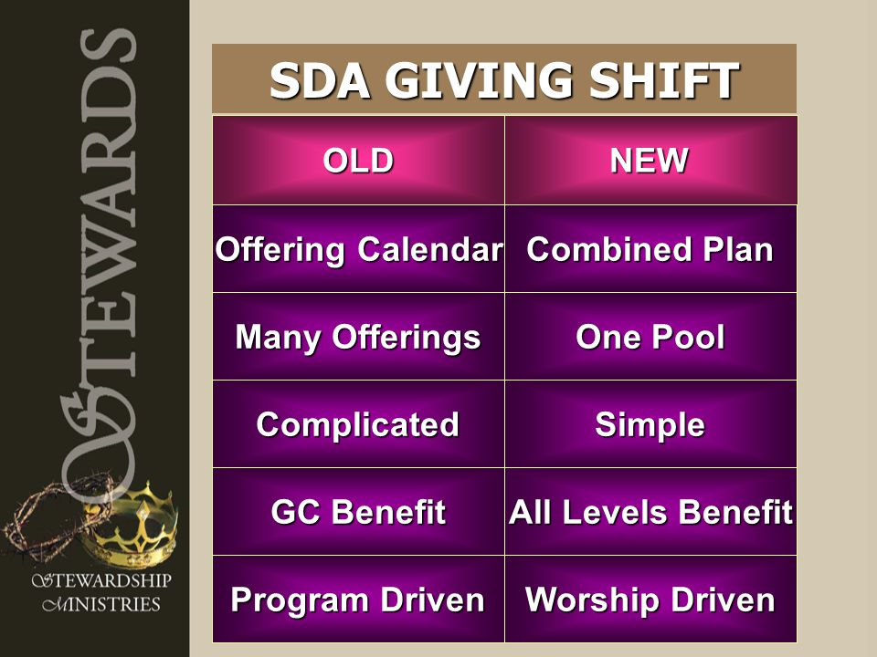

Slide 6
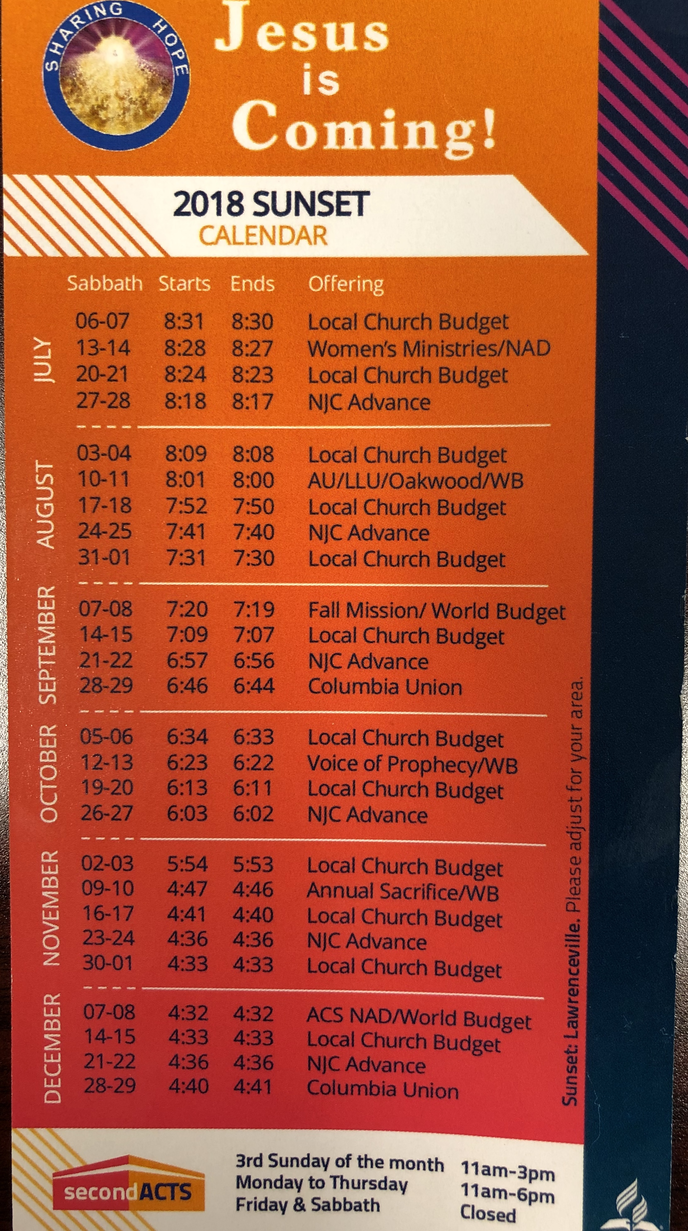
Notes:
2. Las iglesias deben seguir el calendario de ofrendas. Dos sábados de cada mes es para la iglesia local y los otros dos sábados son para el avance de la obra a nivel de conferencia y a nivel mundial. La iglesia mundial necesita también las ofrendas para el avance de la obra.

Slide 7
Offerings to the NAD / General Conference
Offerings to missions (SS): 25% is for special projects of the General Conference and 75% goes to missions.
Offerings of Birthday and Gratitude: 100% goes to the missions
Annual Sacrifice: 100% is sent to spread the gospel to places where there is no Adventist presence.
Investment Fund: 25% goes to Evangelism; 2.5% goes to NAD projects, 72.5% is distributed to the world divisions and their institutions

Slide 8
Offerings to the Conference budget (NJ Advance )
Evangelism..................................35%
Subsidy for church construction..…..45%
Education ..……………………….….…20%

Slide 9

financial report that must be presented at church meetings

Slide 10
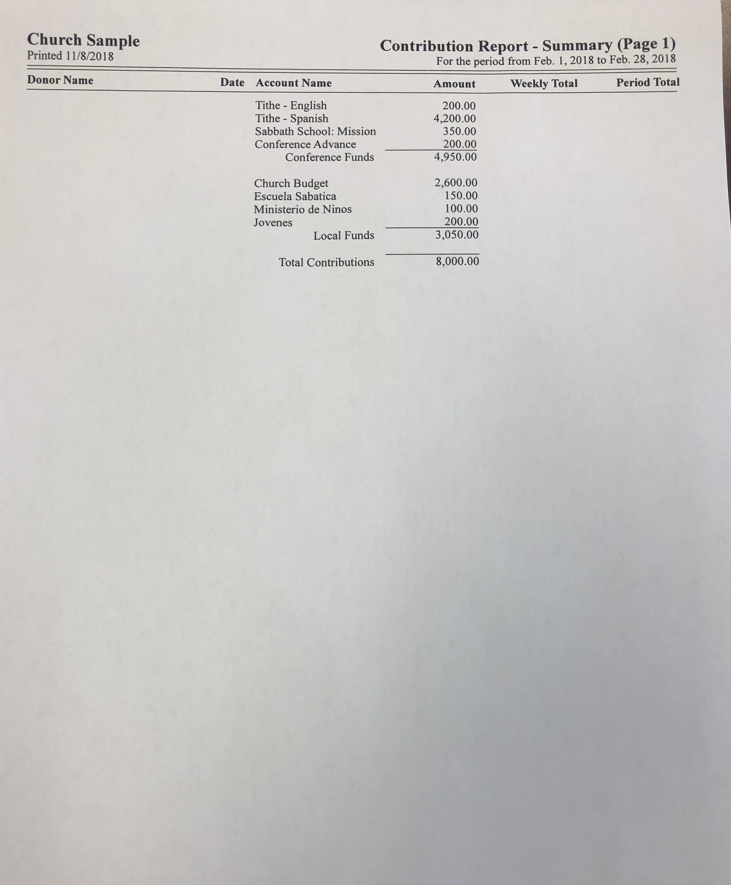
Notes:
Cada junta de iglesia se debe asegurar que los tesoreros presenten sus reportes financieros (Cheques escritos, Transferencias y el Resumen Financiero). Hay iglesias que en las juntas no se presentan los reportes financieros y hay iglesias que no saben cómo están en sus finanzas.

Slide 11
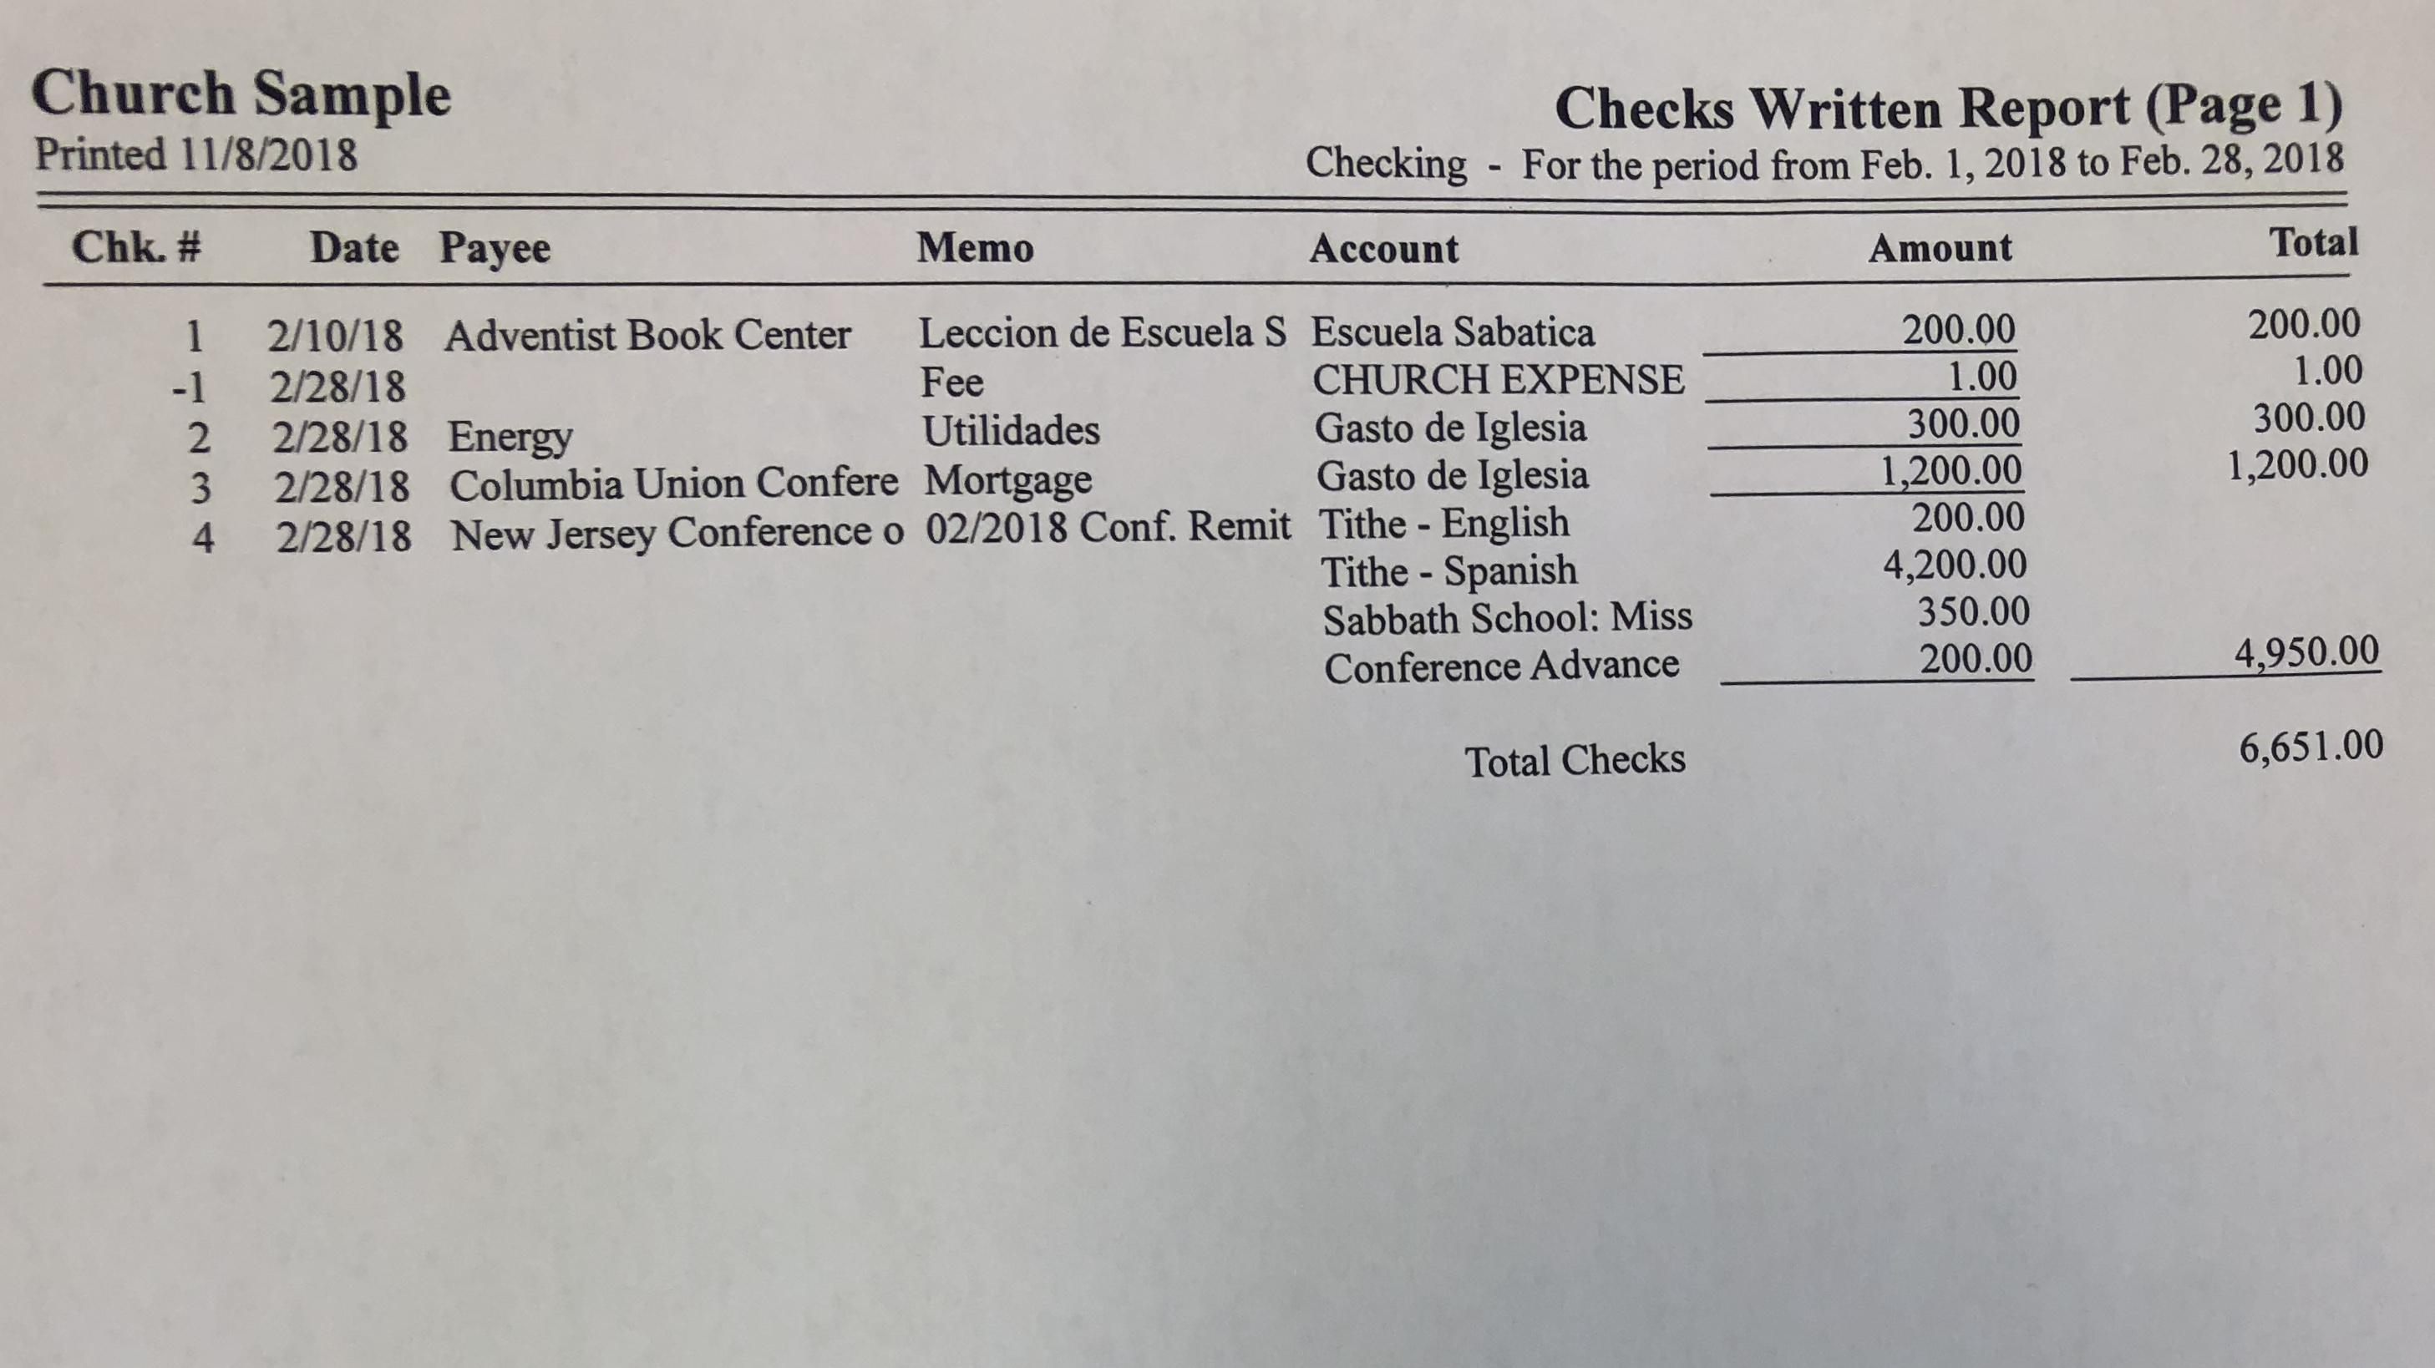

Slide 12
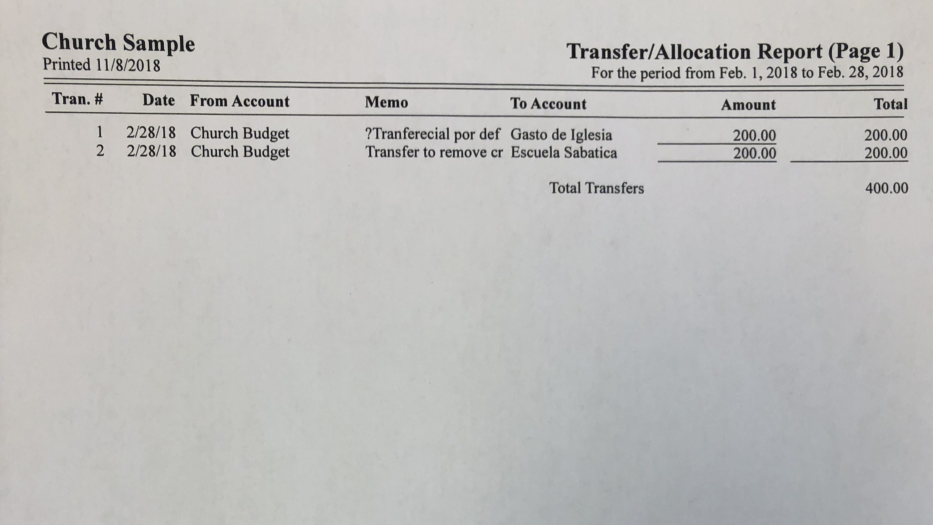

Slide 13
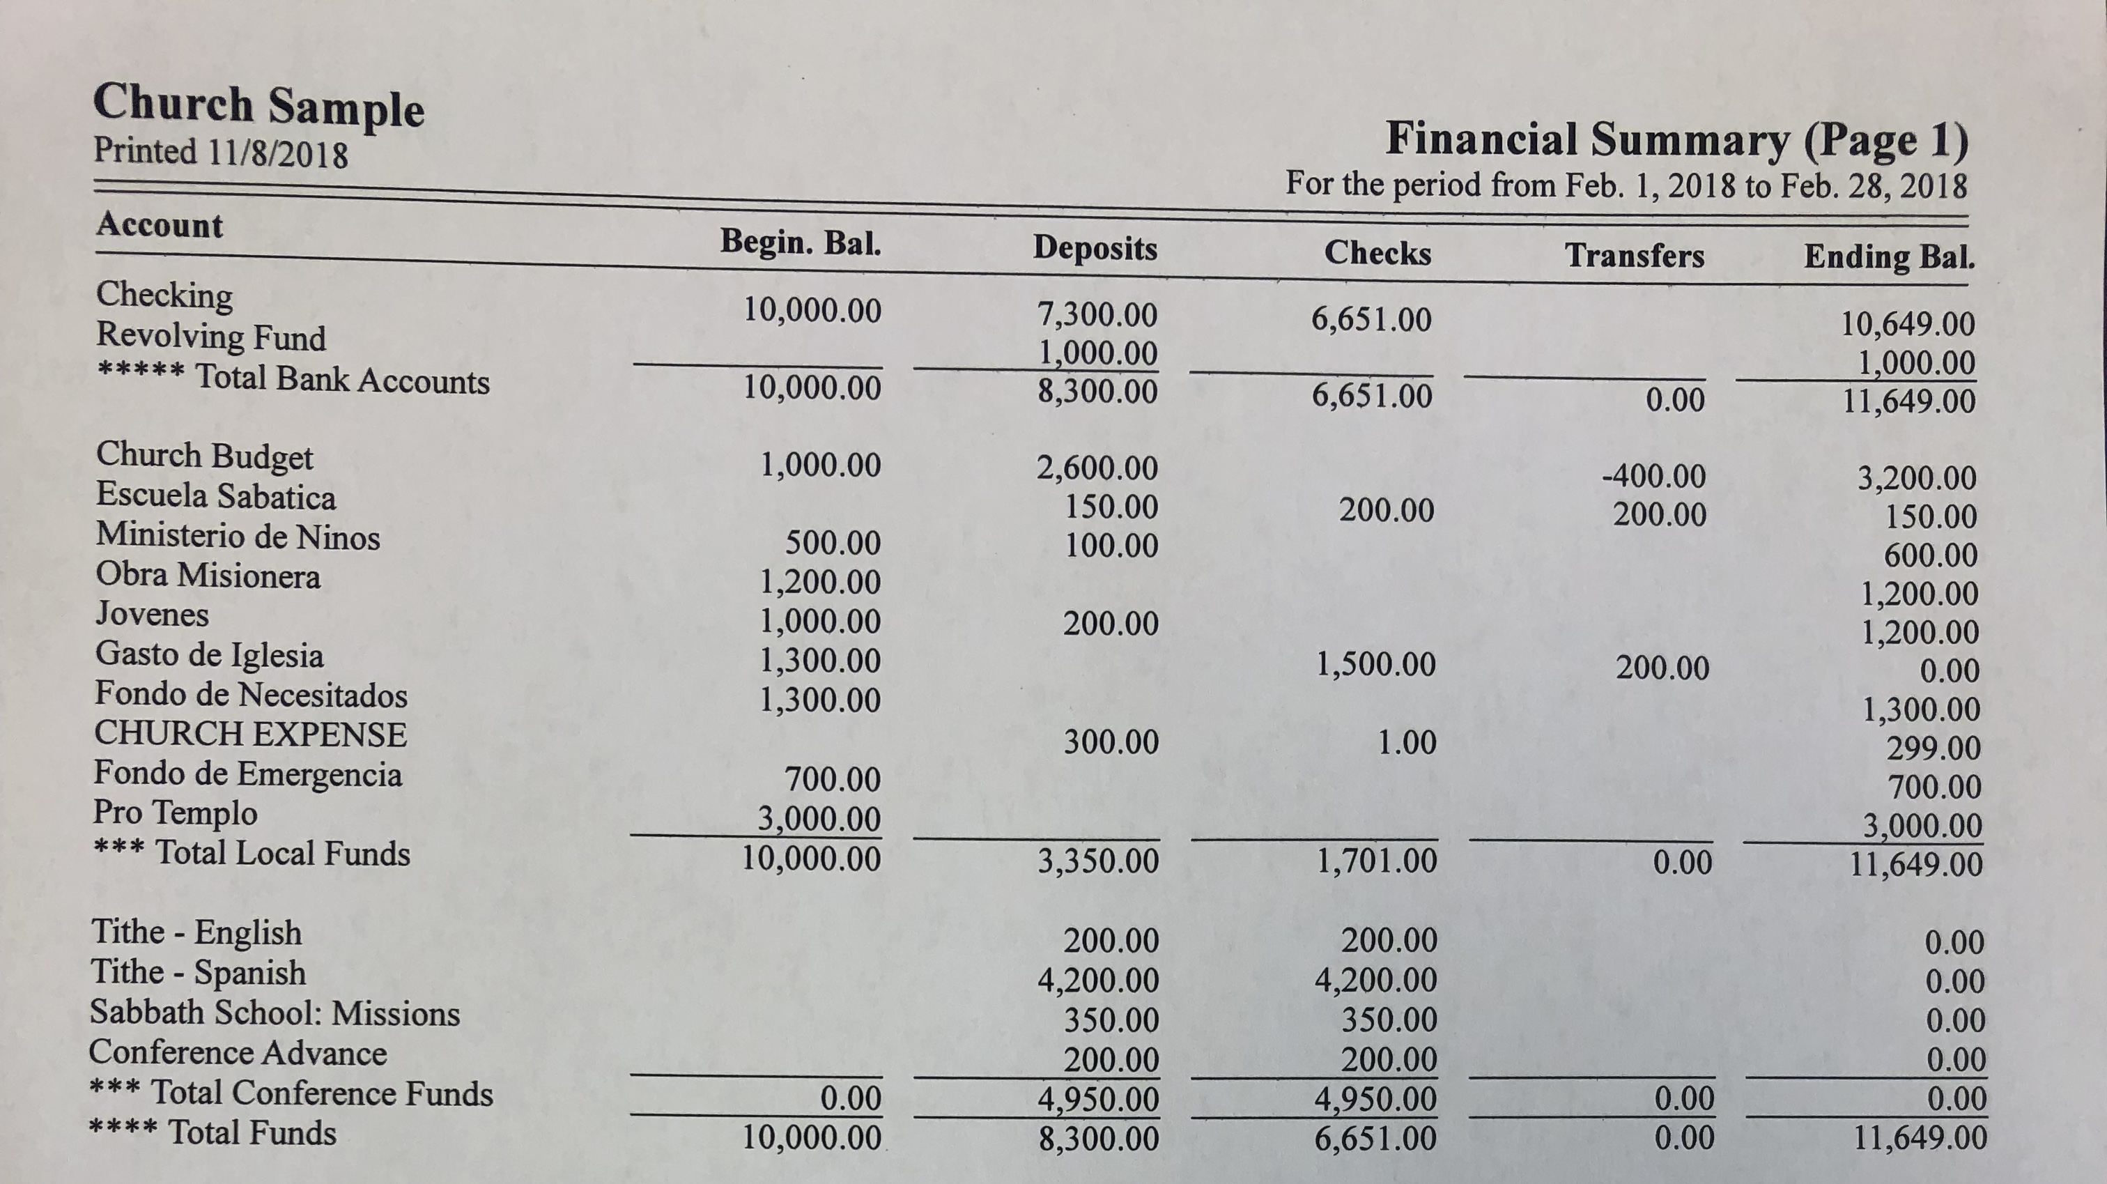

Slide 14


Slide 15
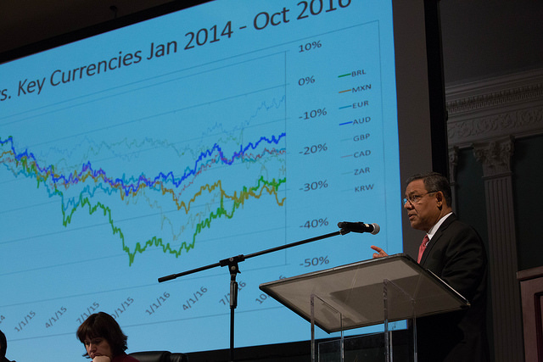
Audit Reports

Slide 16

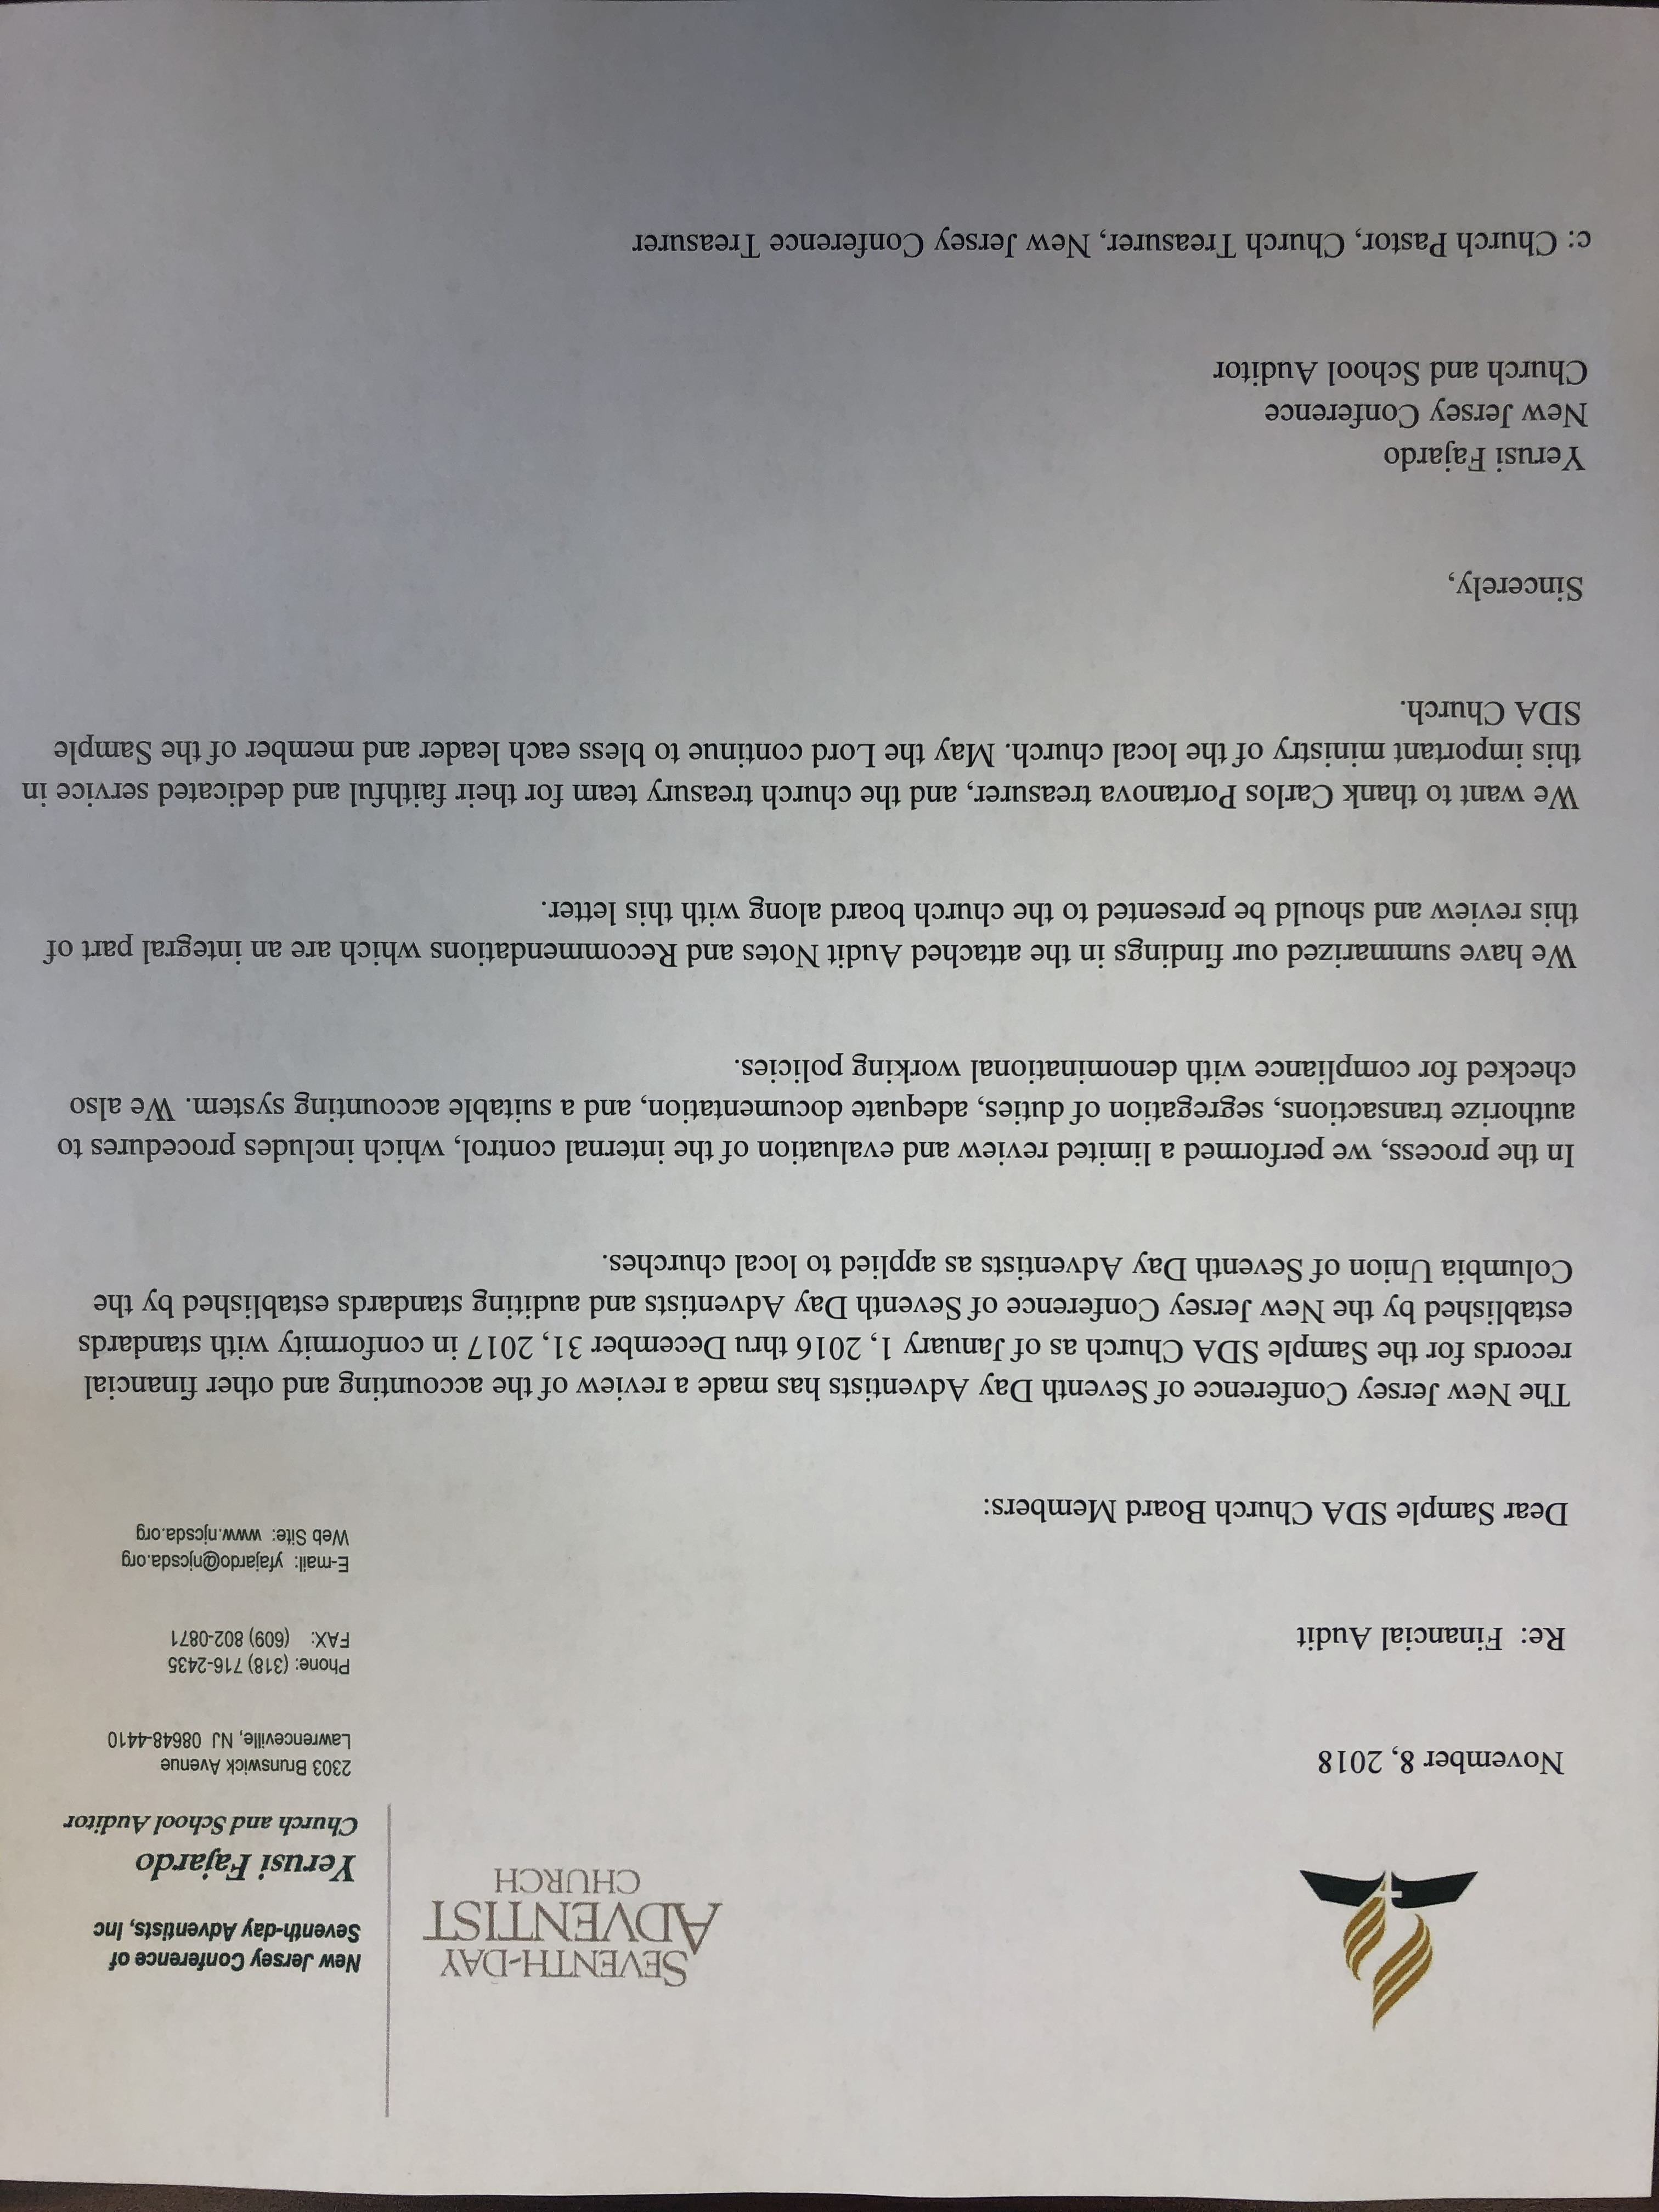
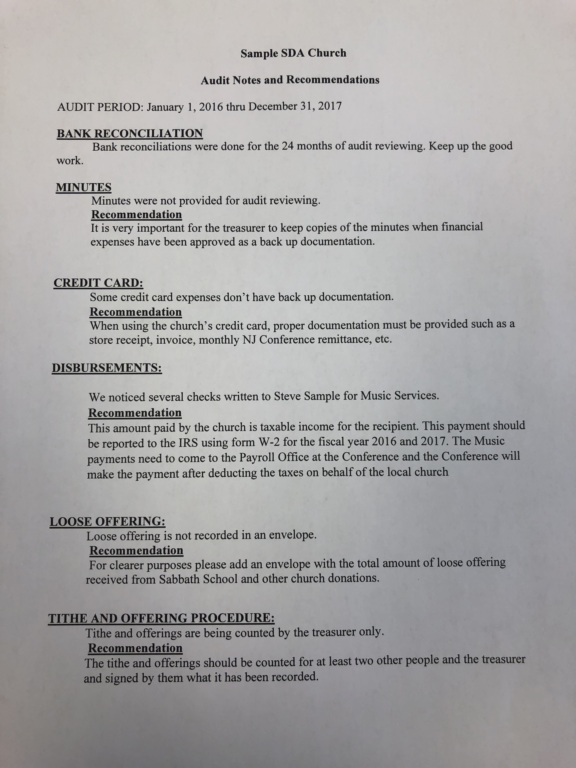
Notes:
Los ancianos deben de asegurarse que el reporte de auditoria debe ser leído y aprobado por la junta de iglesia,

Slide 17

Purchase, construction or remodeling of churches
Notes:
5. Todo proyecto de compra, construcción o remodelación debe ser coordinado a traves del departamento de tesoreria de la conferencia. Lamentablemente hay iglesias que realizan remodelaciones y la conferencia no es notificada. Luego vienen problemas legales por incumplimiento de contratos o por errores en los contratos.

Slide 18
It has to be coordinated with the Treasury Department
The Church Board and the Constituent church members (Business Meeting) need to approve the project.
The NJC Executive Committee Board and ADCOM need to approve the loan and the project before the project begins.
The NJC Administrators are responsible for reviewing and signing the contract. The local pastor or Treasurer can not sign the contract.

Slide 19
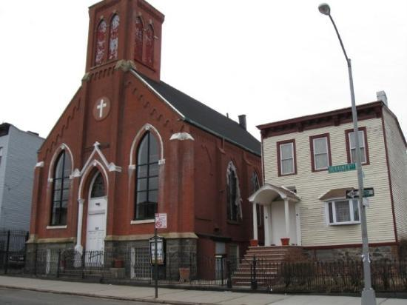
Taxes on properties not used as part of the church service

Slide 20
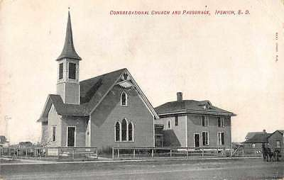
Reasons:
Houses of the churches are rented to brothers and not to ministers (pastors)
Houses of churches or attached properties that are not used for religious services
Properties acquired by churches that pay taxes
Properties of churches that are rented to schools and not used for religious services
Notes:
7. Hay actualmente 6 Iglesias que estan pagando taxes de propiedad por rentales a personas que no son pastores y otras por los tramites de taxes. Tenemos casos de 2 propiedades de las Iglesias que le fueron negadas el tax exempt.

Slide 21
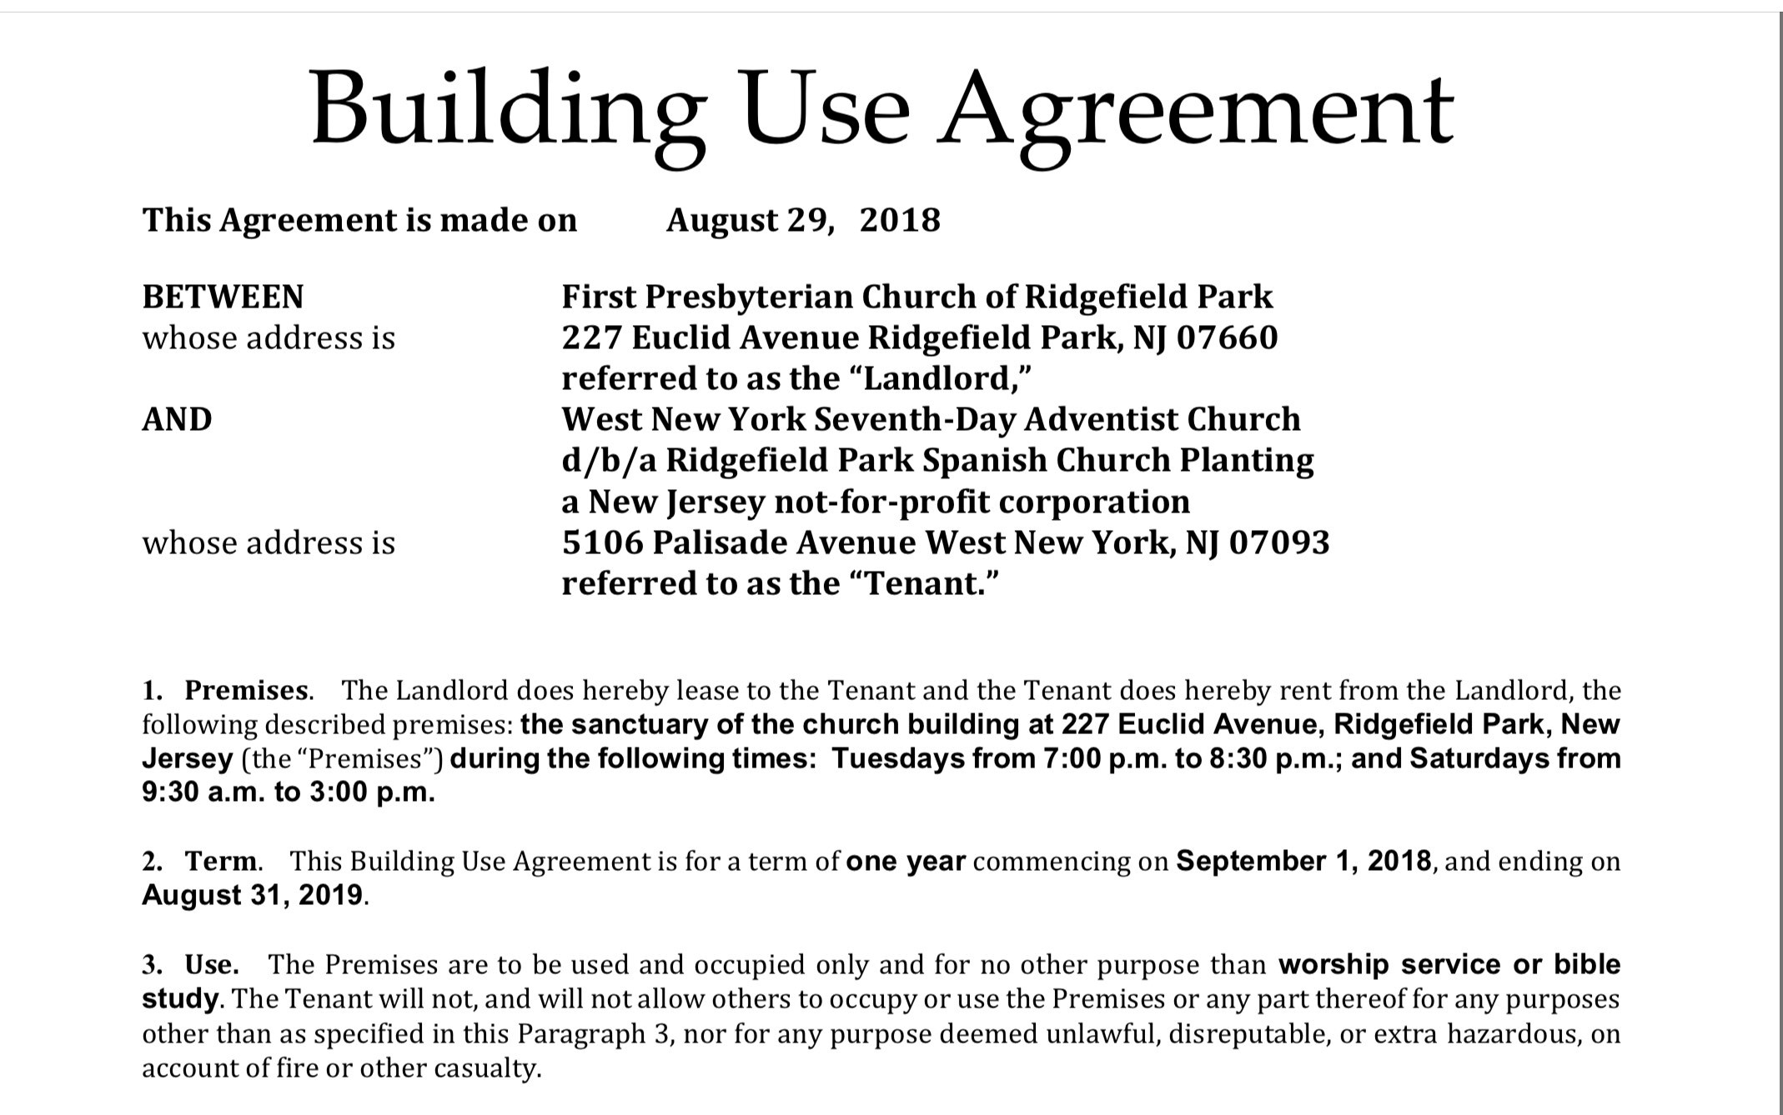

Slide 22


Slide 23
Iglesia Adventista Hispana de xxxx
Recomendación para el Presupuesto del 2018
Presupuesto |  | $2,552.00 |  |  |  | $30,624.00 |  | 100%
Gastos Fijos y Variables |  | Mensual |  |  |  | Monto Anual |  | Porcentaje
Gastos de Iglesia |  | 200.00 |  |  |  | 2,400.00 |  | 7.84%
Fondos de Hipoteca |  | 1,300.00 |  |  |  | 15,600.00 |  | 50.94%
Limpieza de Iglesia |  | - |  |  |  | - |  | 0.00%
Dumpster |  | 50.00 |  |  |  | 600.00 |  | 1.96%
Copiadora |  | 135.00 |  |  |  | 1,620.00 |  | 5.29%
Utilidades |  | 700.00 |  |  |  | 8,400.00 |  | 27.43%
Seguro |  | 60.00 |  |  |  | 720.00 |  | 2.35%
Total Gastos Fijos Y Variables |  | 2,445.00 |  |  |  | 29,340.00 |  | 95.81%
Departamentos Combinados
Club de aventureros |  | 14.00 |  | 13% |  | 168.00 |  | 0.55%
Club de Conquistadores |  | - |  | 0% |  | - |  | 0.00%
Dorcas |  | 14.00 |  | 13% |  | 168.00 |  | 0.55%
Escuela Sabática |  | 15.00 |  | 14% |  | 180.00 |  | 0.59%
Evangelismo |  | 20.00 |  | 19% |  | 240.00 |  | 0.78%
Fondo de Emergencia |  | 30.00 |  | 28% |  | 360.00 |  | 1.18%
Ministerio de Jóvenes |  | 14.00 |  | 13% |  | 168.00 |  | 0.55%
Comunicaciones |  | - |  | 0% |  |  |  | 0.00%
Ministerio de la Mujer |  | - |  | 0% |  |  |  | 0.00%
Ahorros |  | - |  | 0% |  |  |  | 0.00%
Total Departamentos Combinados |  | 107.00 |  | 100% |  | 1,284.00 |  | 4.19%

Slide 24
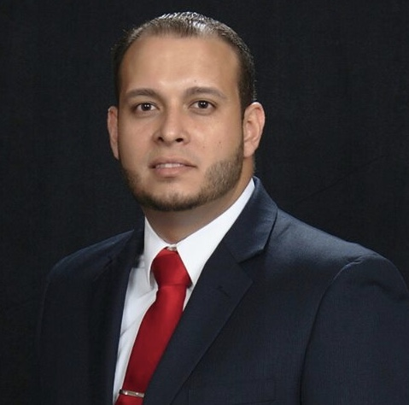
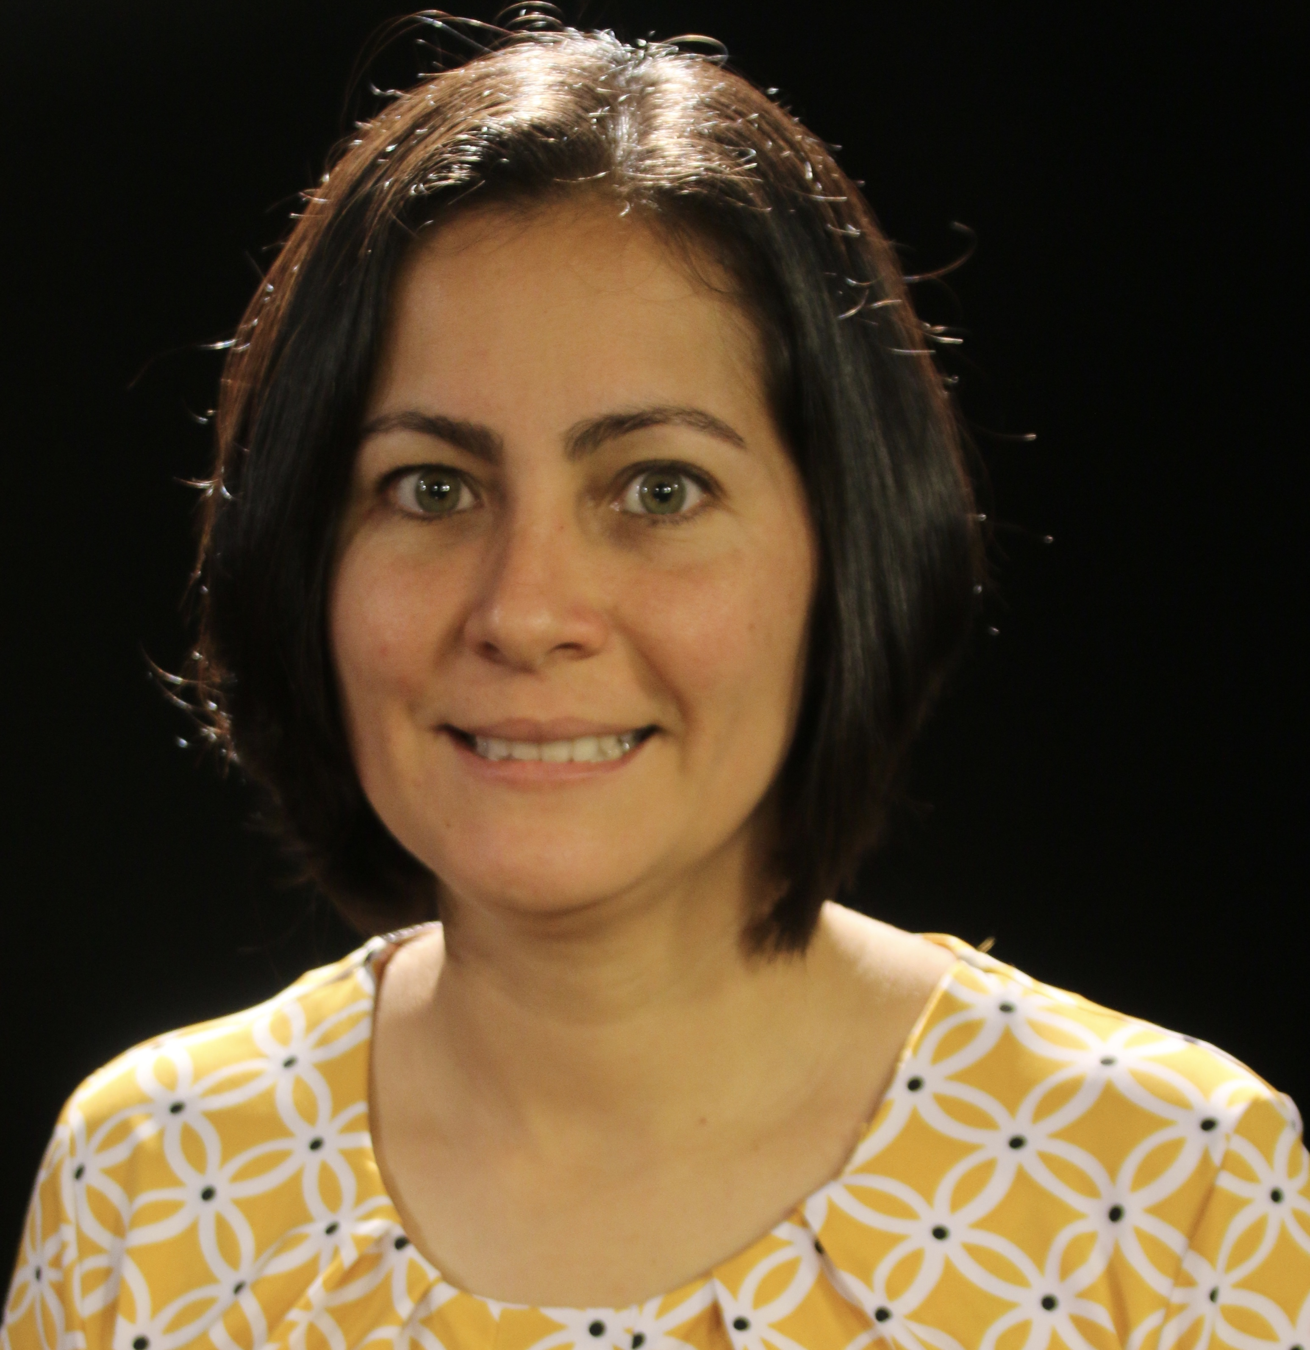
Treasury Department
Karen Senecal
Treasurer
609-802-0860
Luis Lebron
Jr. Accountant
Remittances & Accounts Payables
llebron@njcsda.org
609-802-0865
Carlos Portanova
Undertreasurer
cportanova@njcsda.org
609-802-0860
Yerusi Fajardo
Auditor
yfajardo@njcsda.org
609-802-0864
Edwin Rivera
Senior Accountant
Payroll, Properties & Jewel
erivera@njcsda.org
609-802-0863
Liliana L Nunez
Receptionist/Secretary
lnunez@njcsda.org
609-802-0840
Amalia Aguero
Accountant
Church Insurance & Payroll (Locally Funded) & Billing
aaguero@njcsda.org
609-802-0860
Alberto Vazquez
Information Systems Support Specialist-Jewel
help@njcsda.org
609-802-0836

